Slide 1

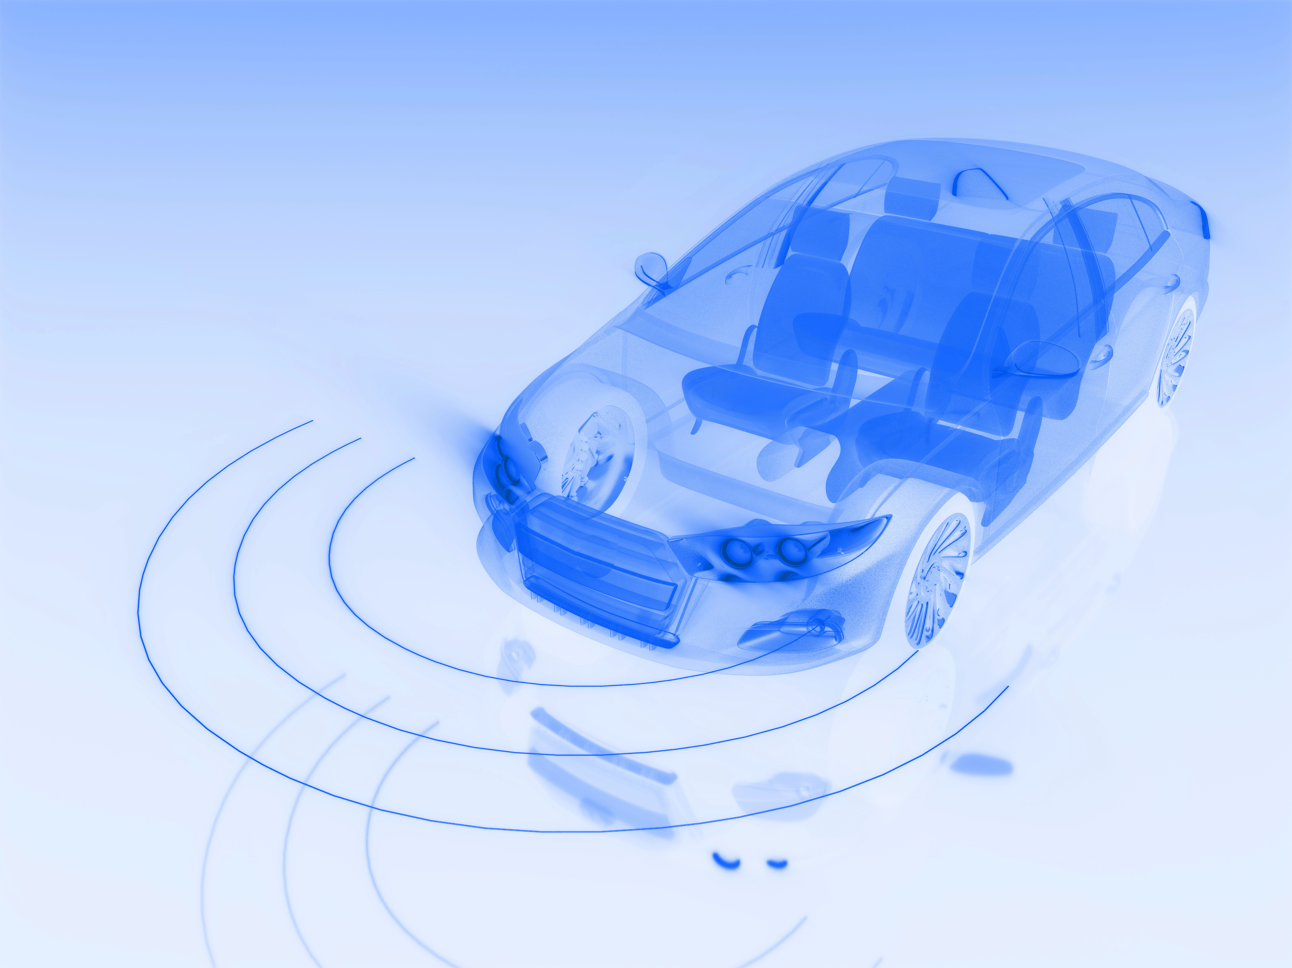


Intelligent Monocular Forward-Vision System (IMFS)

Slide 2







Meet Our Team
Hritik
Jhaveri
Anubuthi Kottapalli
Deepali Dagar
Ashwin Ram Venkataraman
2

Slide 3


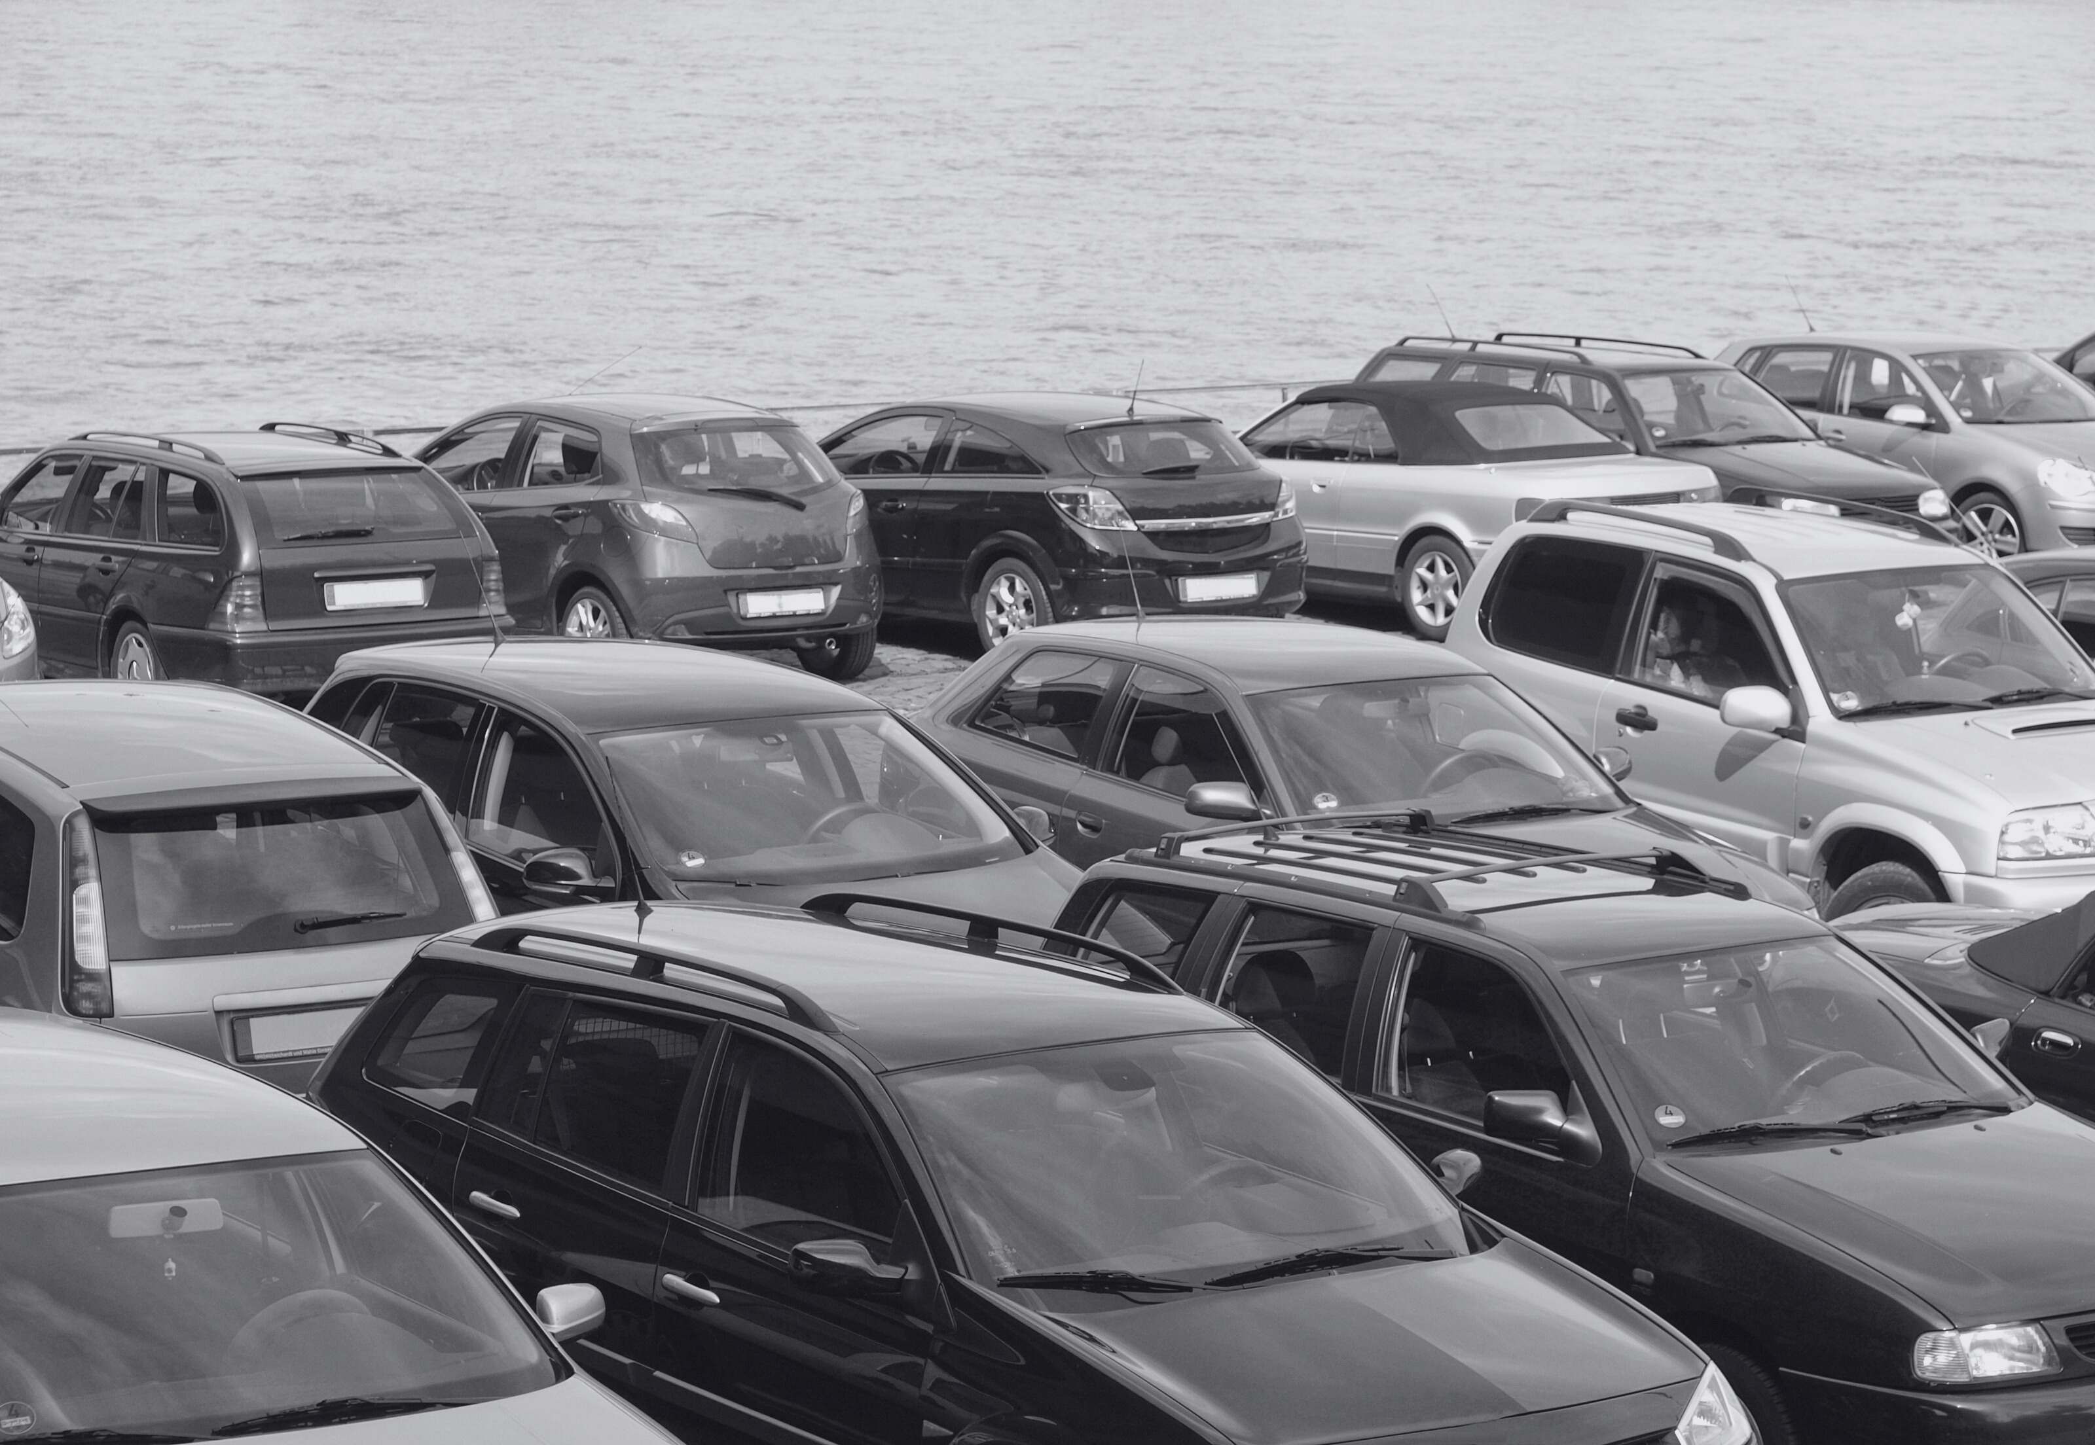
Agenda
Client and Business Statement
1
2
Our Product - IMFS
Model in Action
3
Data is Everything
4
Future Development & Client Statement
5
3

Slide 4








Argonne National Laboratory, one of the U.S. Department of Energy’s 17 national labs, is engaged in cutting-edge research in energy, transportation, and national security. This project is done in collaboration with Connected and Automated Vehicle (CAV) research.
Kevin Stutenberg leads the project, with Michael Pamminger and Yihe Chen providing technical research and implementation.
Advanced Computing & AI
Energy Innovation
Cross-Disciplinary Scientific Research
Client
Business Problem
Our
Product
Model In Action
Data Assesment
Limitations
Future
Scope
4

Slide 5
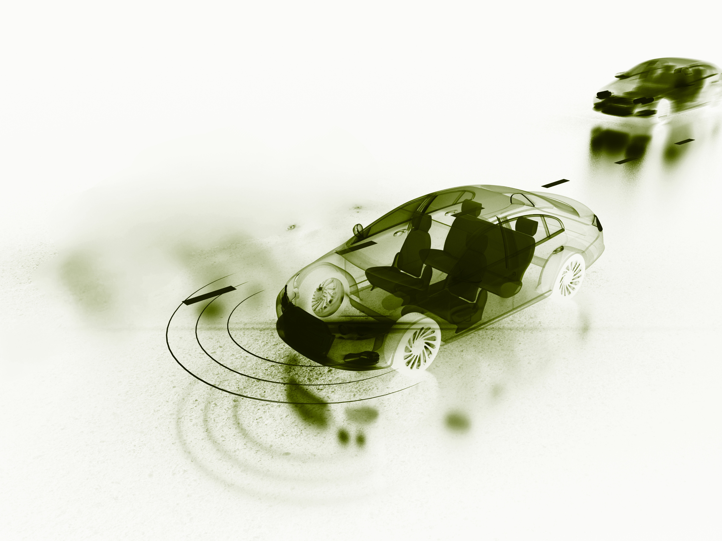
Business Statement
The Problem
Accurate vehicle distance measurement is key to studying driver behavior, but high LiDAR/RADAR costs limit research.
The Opportunity
Provide a scalable, accessible solution that delivers reliable real-time distance estimation using monocular video from common hardware like dash-cams.
Client
Business Problem
Our
Product
Model In Action
Data Assesment
Limitations
Future
Scope
5

Slide 6
Strategic Opportunity & Project Goals
Core Project Goals
Estimate distance to lead car to understand driver behavior.*
Design and benchmark a lightweight, real-time AI model.
Target metrics:
close to real time
model size (<100 MB)
Absolute error ~ 2.00 m *
Client
Business Problem
Our
Product
Model In Action
Data Assesment
Limitations
Future
Scope
6

Slide 7


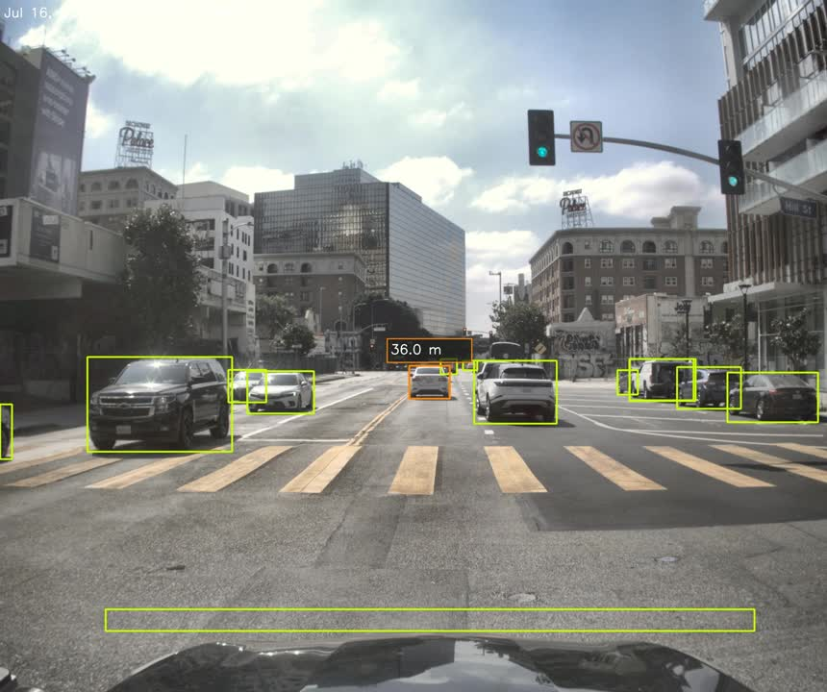
What We Achieved
Client
Business Problem
Our
Product
Model In Action
Data Assesment
Limitations
Future
Scope
7
Notes:
7

Slide 8
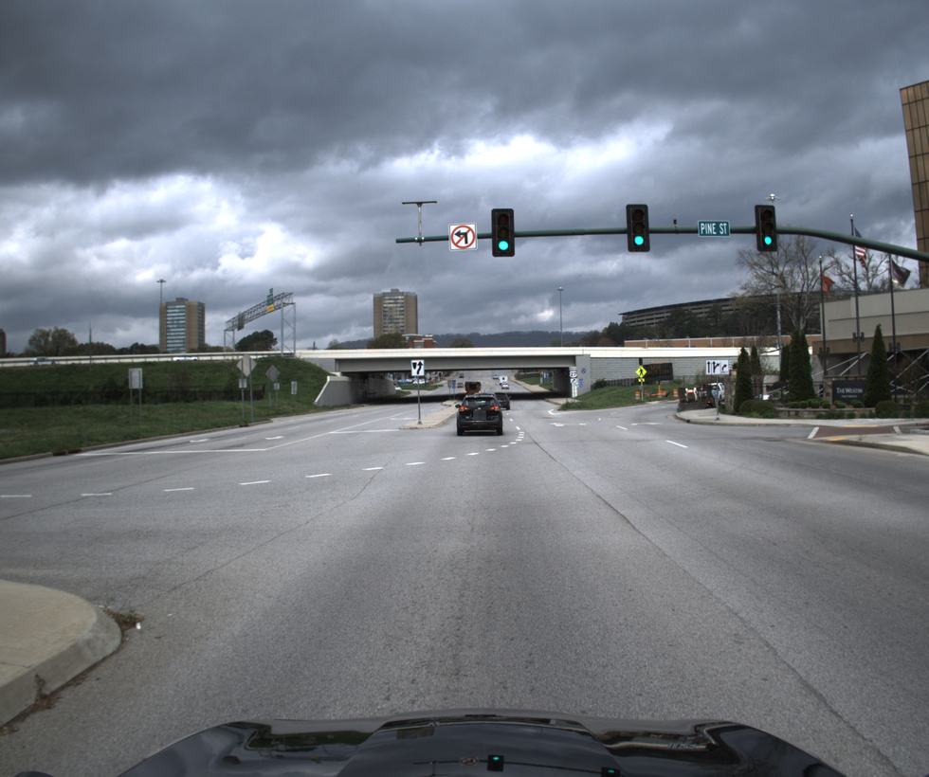
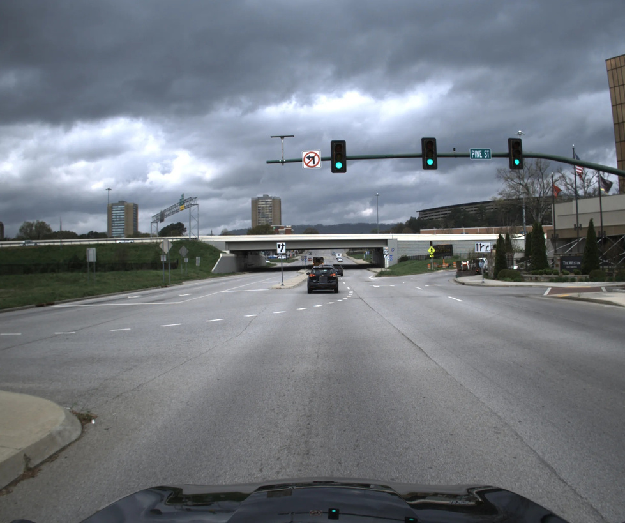
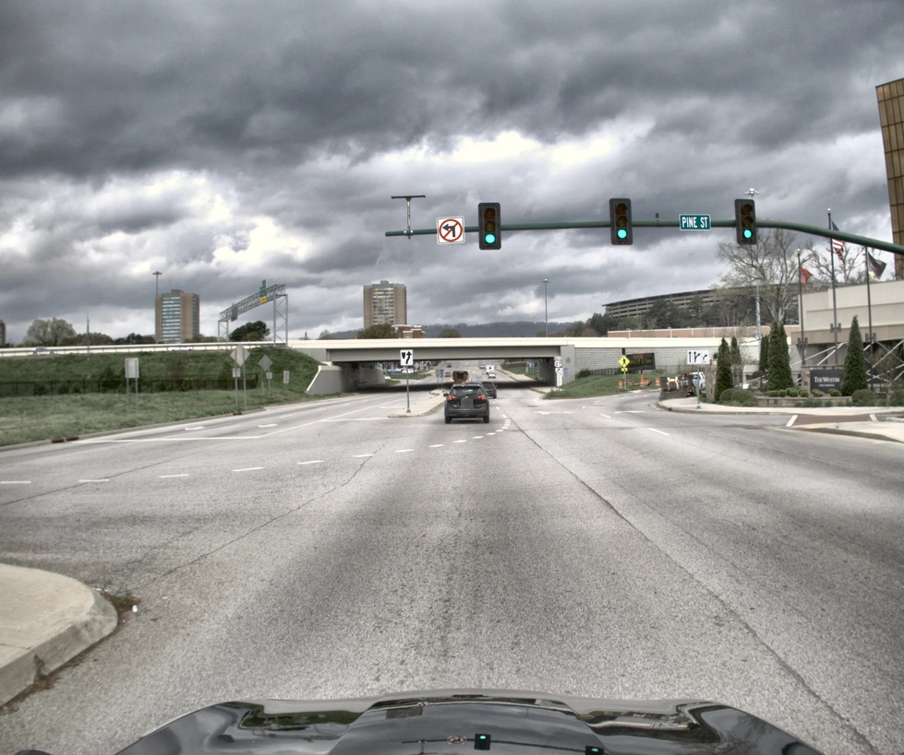
Model in Action: Preprocessing
Raw Image
Undistorted Image
Fully Processed Image
Raw monocular dash-cam frame
Lens distortion removed & perspective
straightened for accurate geometry.
Brightness/contrast normalized
Client
Business Problem
Our
Product
Model In Action
Data Assesment
Limitations
Future
Scope
8

Slide 9
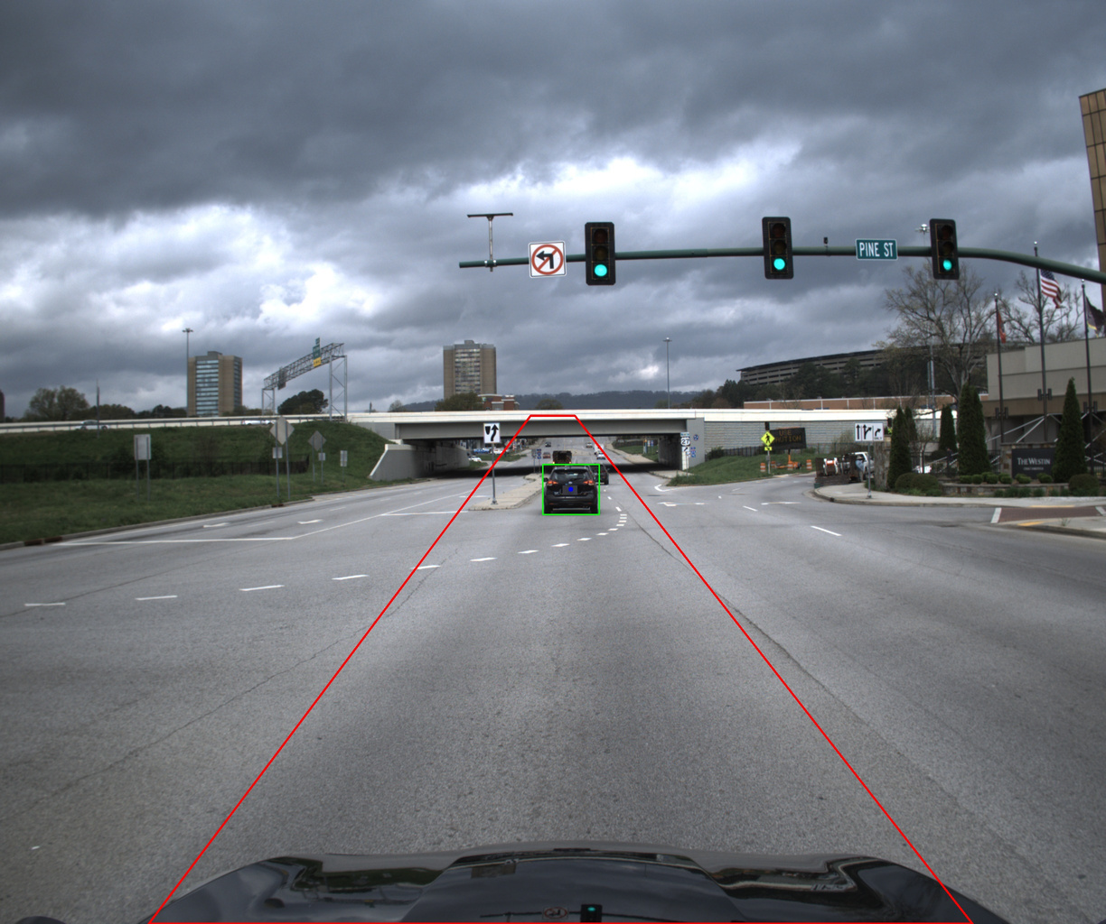
Model in Action: Lead Vehicle Detection
ROI Polygon
Restricts detection to the drivable area, emphasizing the lead vehicle zone.
YOLO - Real Time Object Detection Algorithm
Detects vehicles in real time and provides accurate bounding boxes for the lead vehicle.
Center Focus
Gives priority to vehicles near the vertical center to isolate the true lead vehicle.
Bottom-Crop Heuristic
Removes the bottom 20% of the frame to avoid hood reflections, occlusions, and irrelevant foreground clutter.
Client
Business Problem
Our
Product
Model In Action
Data Assesment
Limitations
Future
Scope
9

Slide 10
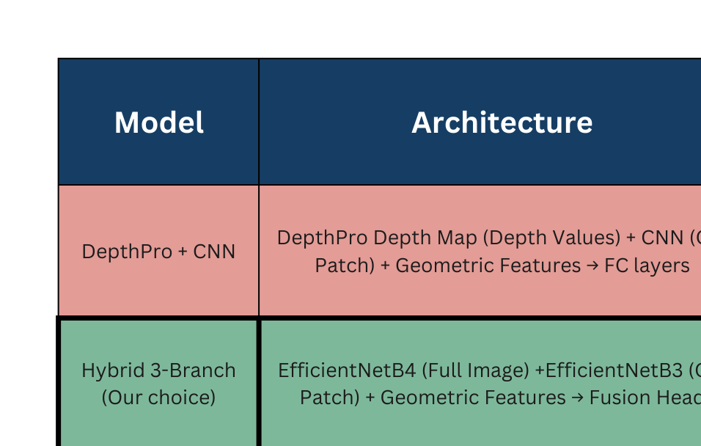
Model in Action: Model Selection
Client
Business Problem
Our
Product
Model In Action
Data Assesment
Limitations
Future
Scope
10

Slide 11
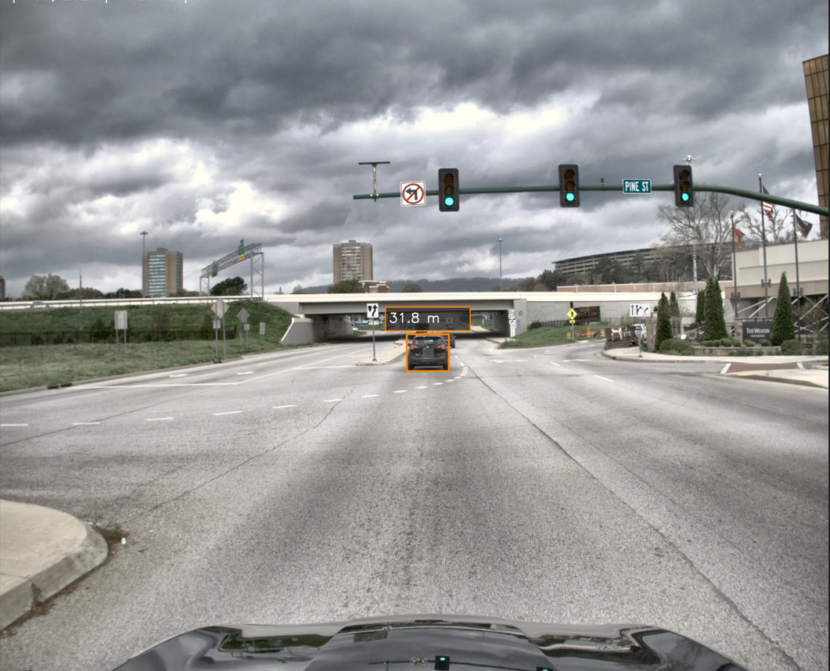
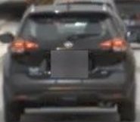
Model in Action: Distance Estimation
Final Ouput
Full Image
Car Patch
Bounding box geometry (width, height, and aspect ratio)
Position (vertical and horizontal) of lead vehicle
Geometric
Features
Client
Business Problem
Our
Product
Model In Action
Data Assesment
Limitations
Future
Scope
11

Slide 12
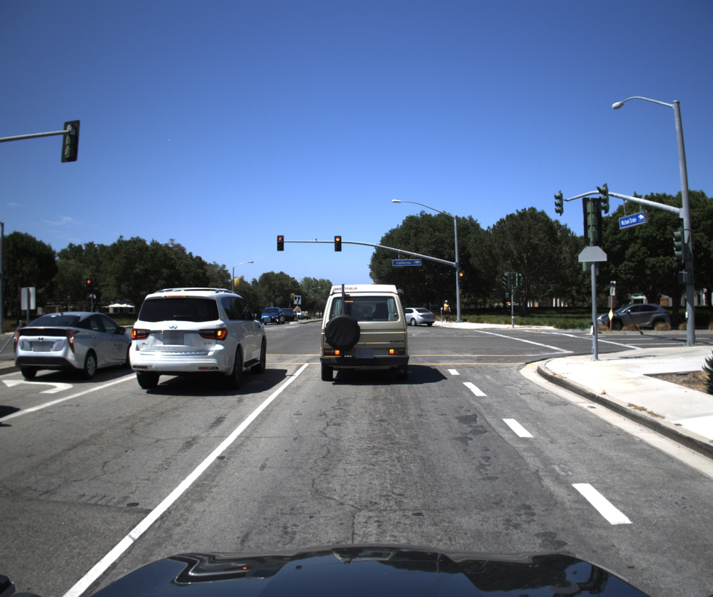
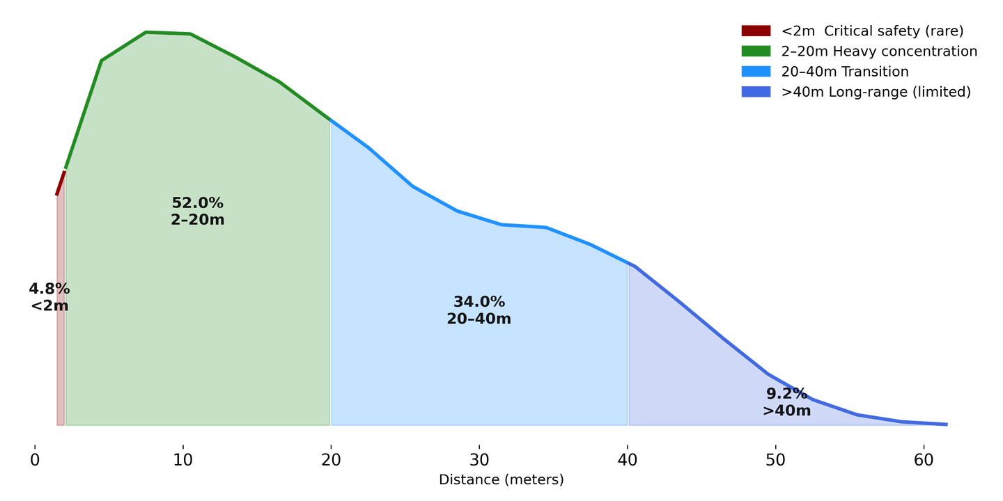
Understanding Our Data
Raw Dashcam Image
Dataset Distribution
Heavy concentration in 0-30m range - reflects typical city driving patterns
Critical safety range underrepresented - only 4.8% of samples under 2m
Long-range samples (>40m) are limited
Argonne National Lab dataset - PII filtered, proprietary
19,000+ images across LA, Nashville, Chattanooga
Ground truth distances encoded in filenames
Client
Business Problem
Our
Product
Model In Action
Data Assesment
Limitations
Future
Scope
12

Slide 13
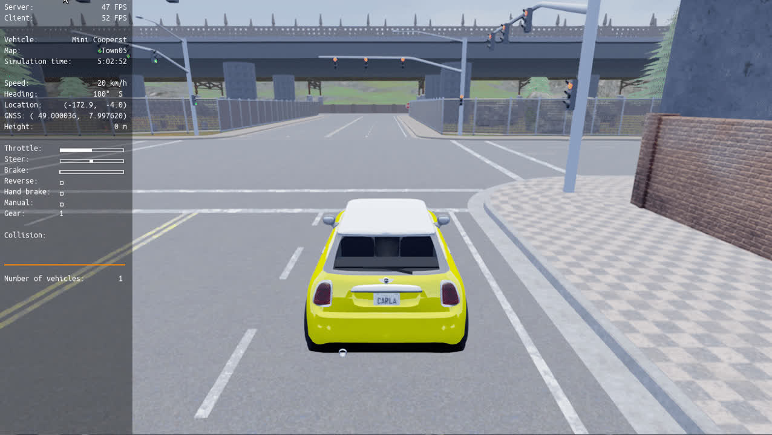
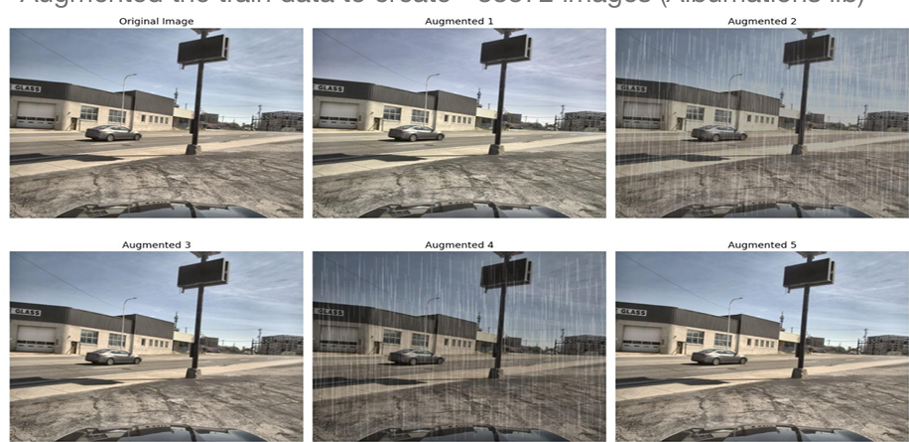
Improving Our Data
Method 1: Simulated data
Method 2: Augmentation
CARLA simulator used to generate balanced distance samples
Synthetic-to-real domain gap too large - model failed to generalize from simulated to real dashcam images
Weather, lighting, and blur augmentations applied
Better Generalization compared to Synthetic CARLA Data
Client
Business Problem
Our
Product
Model In Action
Data Assesment
Limitations
Future
Scope
13

Slide 14
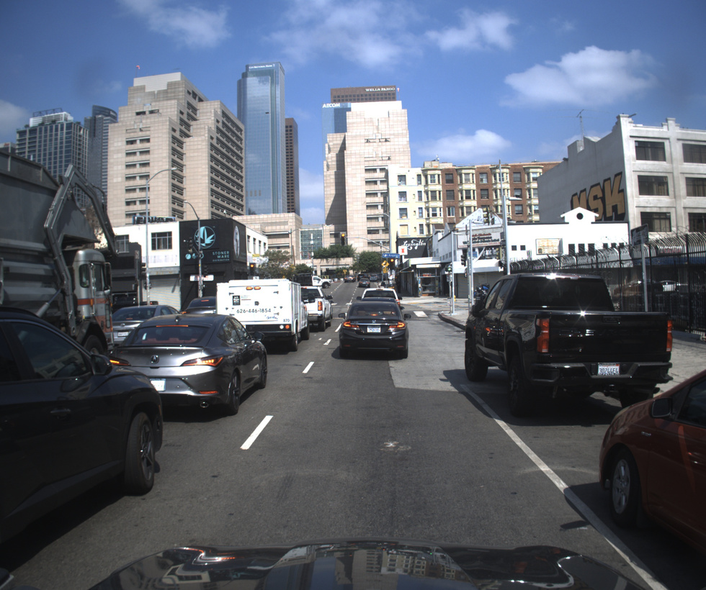
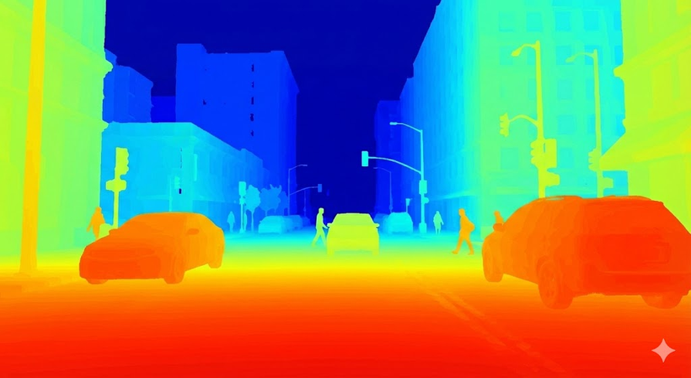
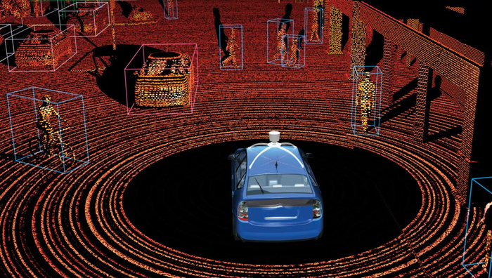
Monocular Vision Ambiguity
A single camera lacks true depth perception, making distance an estimation rather than a precise measurement (unlike Stereo Vision, RGBD camera, LiDAR)
CAMERA OUTPUT
RGB-D OUTPUT
LiDAR OUTPUT
Client
Business Problem
Our
Product
Model In Action
Data Assesment
Limitations
Future
Scope
14

Slide 15
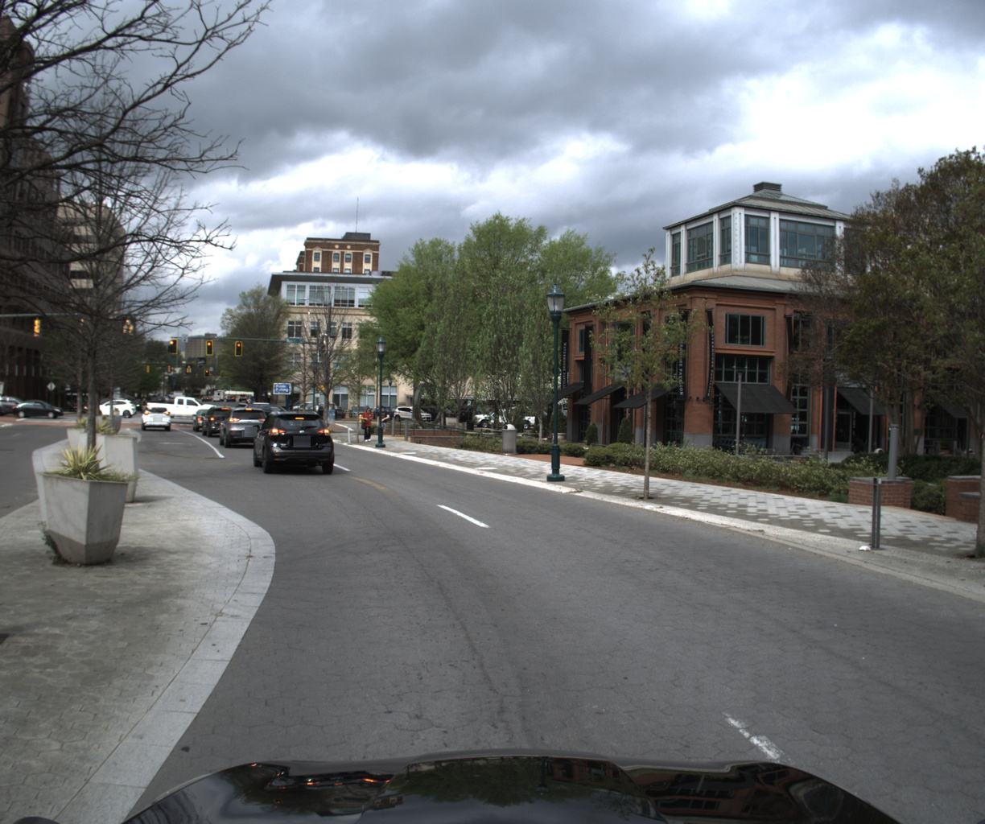
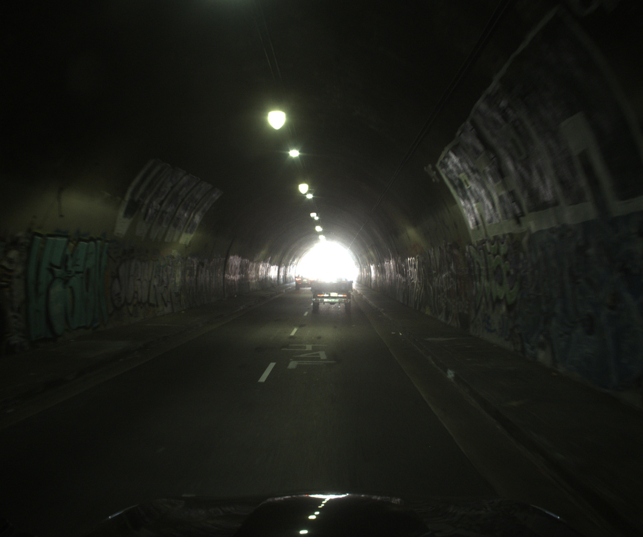
Edge Cases
Sharp Turns
Extreme Light & Weather conditions
Client
Business Problem
Our
Product
Model In Action
Data Assesment
Limitations
Future
Scope
15

Slide 16

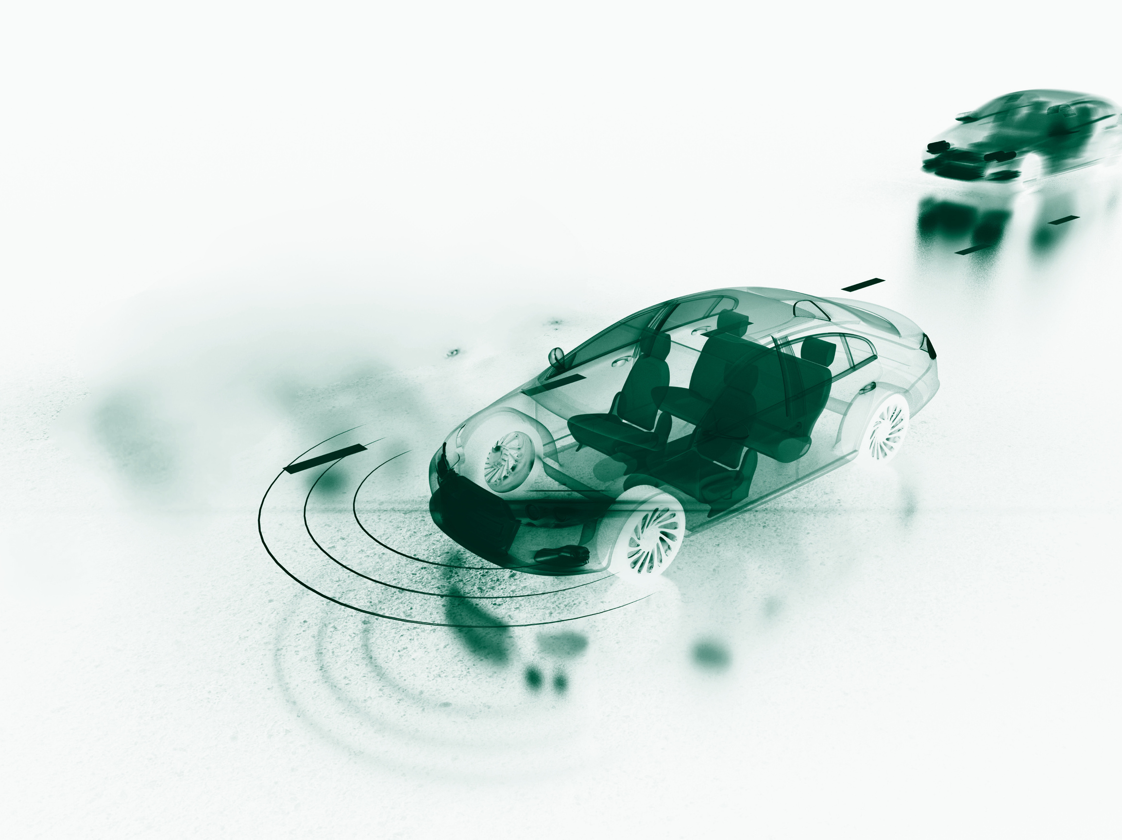
Future Improvements
• Multi‑modal Input (Vision + Vehicle Control Signals)
Fuses camera data with vehicle dynamics for robust perception.
• Temporal / Multi‑frame Inference
Leverages sequential frames to improve distance estimation accuracy.
• Adaptive Depth Estimation
Dynamically adjusts predictions for varying road and traffic conditions.
Client
Business Problem
Our
Product
Model In Action
Data Assesment
Limitations
Future
Scope
16

Slide 17
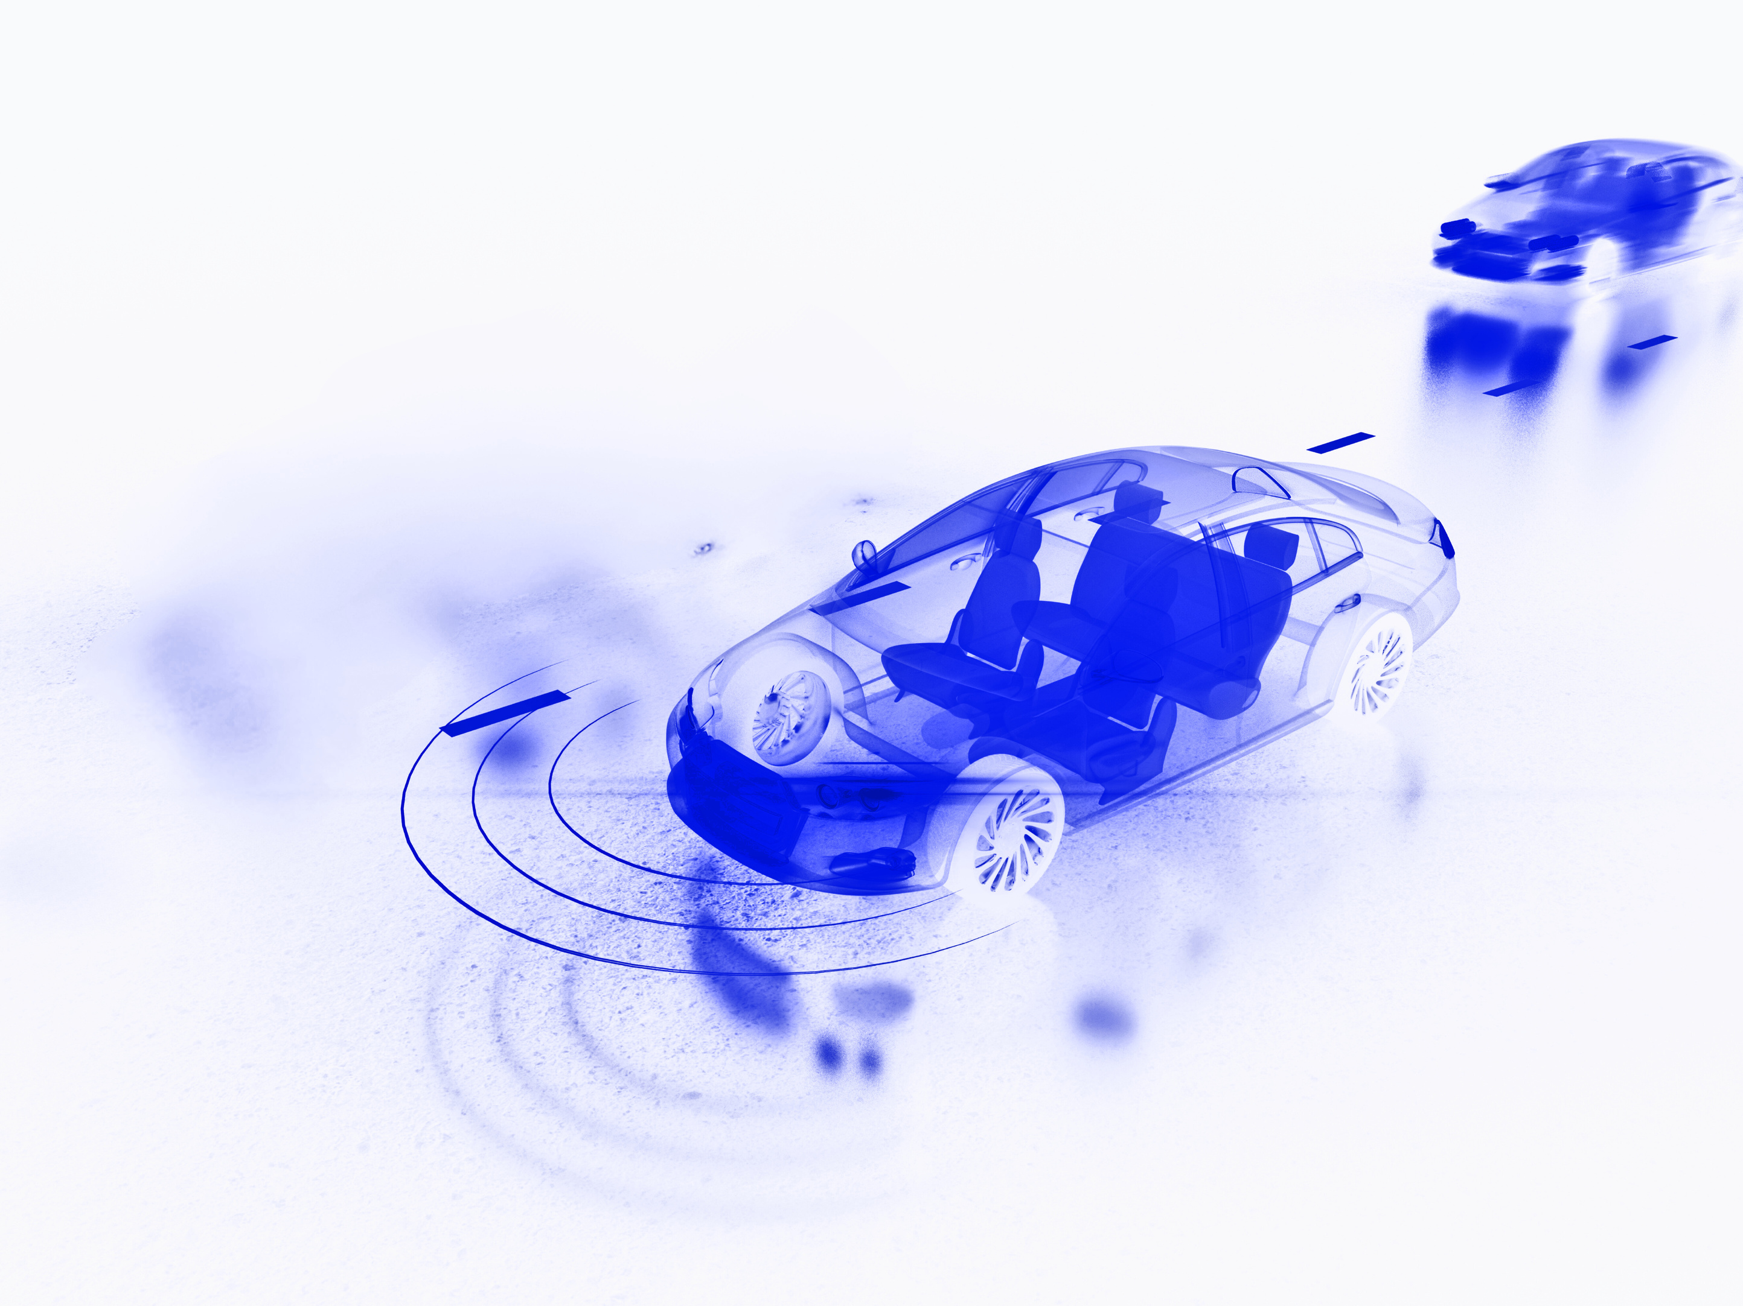
Client Statement
17

Slide 18
Thank you!

Slide 19
Appendix
19

Slide 20
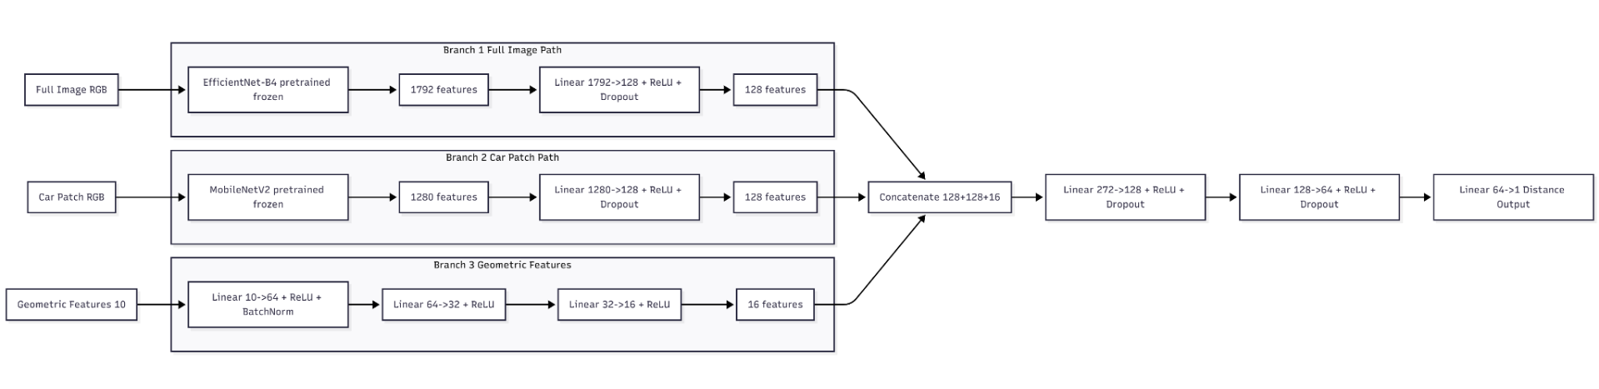
MODEL ARCHITECTURE
20

Slide 21
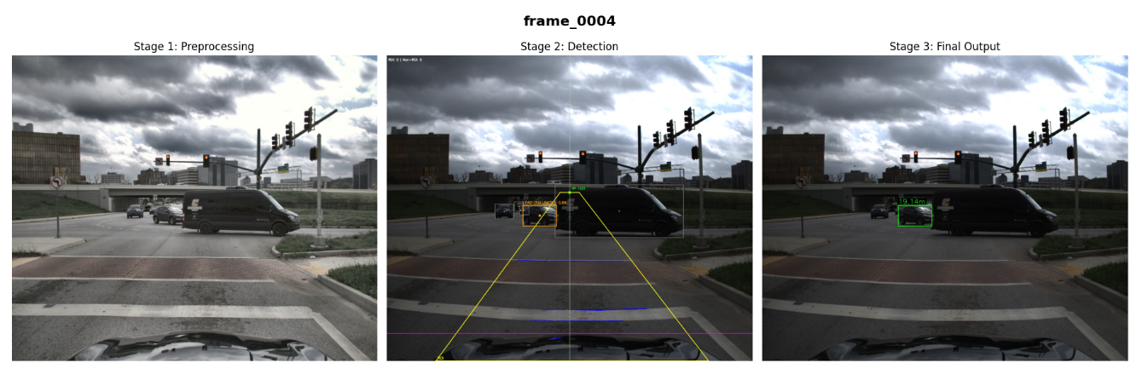
INFERENCE OUTPUT
21

Slide 22
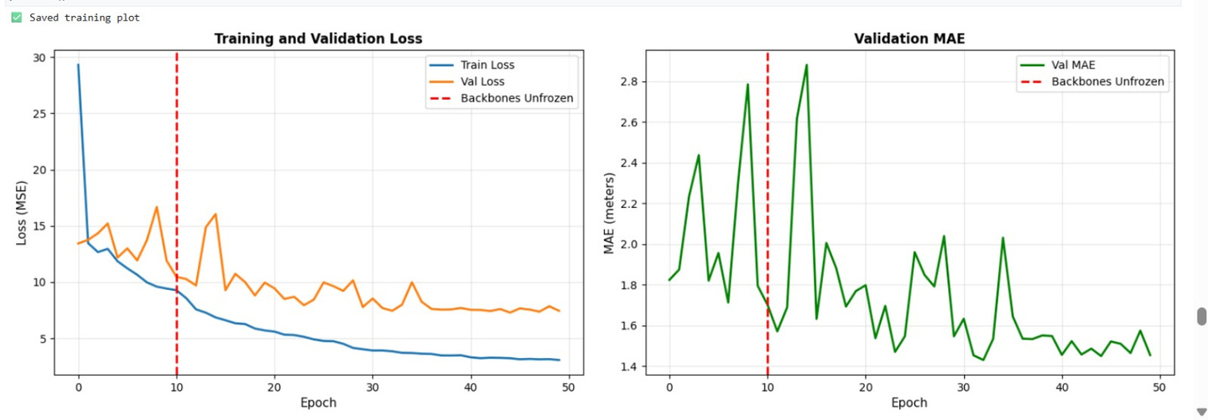
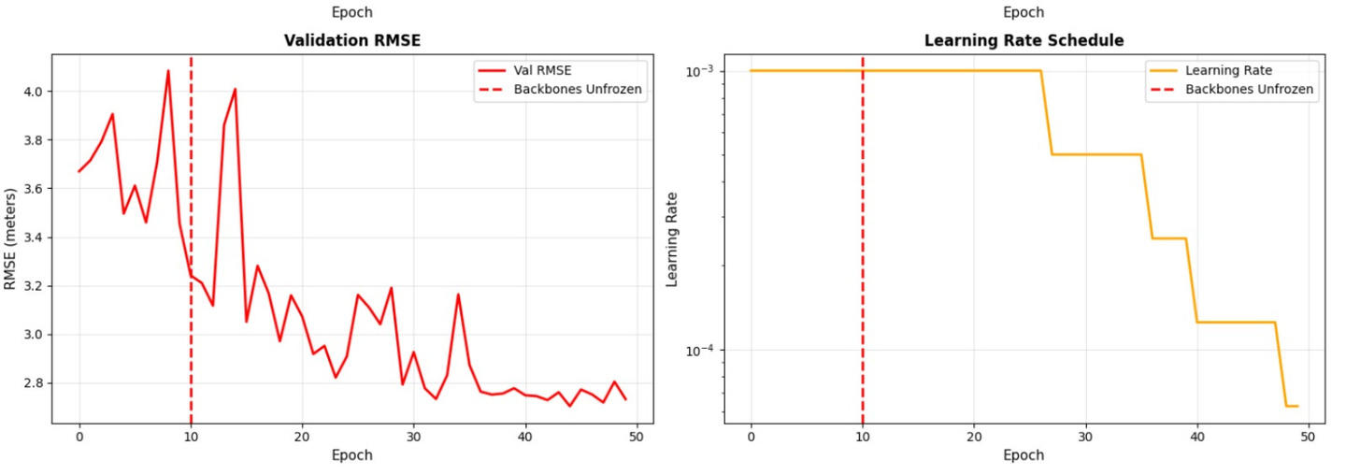
MODEL EVALUATION
22

